Slide 1

Junior Uniform
Senior Uniform
Sports Uniform
Other

Slide 2
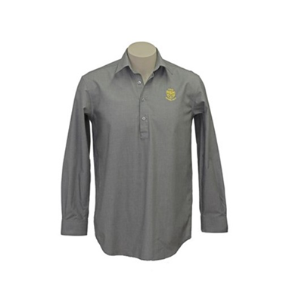
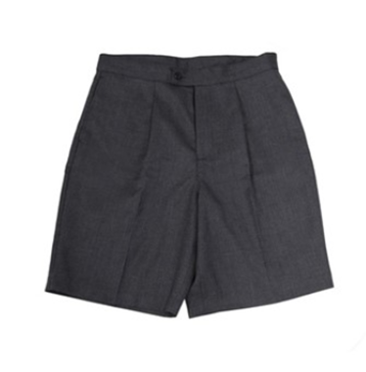
Junior Uniform
Senior Uniform
Sports Uniform
Other

Slide 3
Junior Uniform
Senior Uniform
Sports Uniform
Other

Slide 4
Junior Uniform
Senior Uniform
Sports Uniform
Other

Slide 5
Junior Uniform
Senior Uniform
Sports Uniform
Other

Slide 6

Junior Uniform
Senior Uniform
Sports Uniform
Other

Slide 7
Junior Uniform
Senior Uniform
Sports Uniform
Other

